Slide 1
2nd Virtual Public Informational Meeting
Texas Conservation Plan for the Dunes Sagebrush Lizard
Notes:
Gene: Thank you for joining us today for ACF’s 2nd virtual public informational meeting. My name is Gene Richardson, and I am President and Treasurer of American Conservation Foundation (ACF) and Permit Holder for the Dunes Sagebrush Lizard (DSL) in Texas. With me today I have Steve Manning, my Qualified Third-Party Contractor with NRS, who is joined by his GIS Specialist David Jones, as well as Angela Garcia, my Administrative Assistant. I will turn it over to Steve for the presentation on ACF. We’ll give a little background on who we are, provide information on deliberations regarding the DSL and explain the enrollment process with ACF. Steve -
Steve: Yes, thank you Gene. My name is Steve Manning. I am [President] of Natural Resources Solutions, LC (NRS) and a Qualified Third-Party Contractor (QTPC) for ACF. Today well run through everything from the basics on the Endangered Species Act, to some background on the DSL and deliberations surrounding the DSL, as well as explain how to enroll with ACF and the responsibilities of becoming a Participant in the TCP.

Slide 2
Agenda
Laws and Regulations – ESA Background
ESA Listing Process
Candidate Species
Candidate Conservation Agreement with Assurances (CCAA)
DSL Background
USFWS Proposed Rule to list the DSL
DSL Previous Federal Actions
DURING THE PRESENTATION YOU MAY SUBMIT QUESTIONS VIA THE ZOOM CHAT.
Questions will be answered in the order received at the end of the presentation.
2023 DSL Proposal to List Deadlines
Texas Conservation Plan Background
American Conservation Foundation, Inc.
Enrollment in the TCP
DSL Maps/Models
Certificate of Inclusion (CI)
*Q&A Session*
CONFIDENTIALITY – ONLY ACF AS THE MEETING ADMINISTRATOR WILL SEE YOUR QUESTION.
ACF will read your question aloud while maintaining your confidentiality.
Notes:
Here is the agenda for today’s presentation.
During the presentation you may submit questions via the Zoom chat. Only ACF as the meeting administrator will see your question. We will maintain your confidentiality and read the question aloud in the order received during the Q&A session at the end of this presentation.

Slide 3
Laws and regulations - Endangered species act (ESA) -
Enacted in 1973 to prevent loss or harm of endangered and threatened species and to protect the species’ habitat.
Provides legal protection to plants and animals that are defined as threatened or endangered.
The prohibitions of Section 9(a)(1) of the ESA, make it illegal for any person subject to the jurisdiction of the U.S. to take endangered wildlife within the U.S. or on the high seas.
Notes:
The Endangered Species Act (ESA) was enacted in 1973 to prevent loss or harm of endangered and threatened species and to protect the species’ habitat.
The ESA provides legal protections to plants and animals that are defined as threatened (likely to become endangered in the foreseeable future) or endangered (in danger of extinction).
The prohibitions of Section 9(a)(1) of the ESA, codified at 50 CFR 17.21, make it illegal for any person subject to the jurisdiction of the U.S. to take endangered wildlife within the U.S. or in the high seas. ‘Take’ includes to harass, harm, pursue, hunt, shoot, wound, kill, trap, capture, or collect; or to attempt any of these.

Slide 4
ESA Listing Process
Petition
Candidate Assessment
Status Review
Proposed Rule
Public Comment
Final Rule
Listing a species under the ESA involves several steps
Notes:
The ESA listing process involves several steps:
Petition: The process typically begins when someone submits a petition to the U.S. Fish and Wildlife Service (FWS) requesting that a species be listed as threatened or endangered. This petition should include scientific evidence supporting the need for listing.
Candidate Assessment: After receiving a petition, the FWS conducts an initial review to determine if the petition presents substantial information indicating that listing may be warranted. If so, the species becomes a "candidate" for listing.
Status Review: If the species is deemed a candidate, the FWS conducts a comprehensive status review. This review involves gathering and analyzing scientific data on the species' population size, distribution, habitat, threats, and other relevant factors.
Proposed Rule: Based on the findings of the status review, the FWS publishes a proposed rule in the Federal Register. This proposed rule outlines the agency's recommendation for whether the species should be listed as threatened or endangered and provides an opportunity for public comment.
Public Comment Period: Once the proposed rule is published, there is a period during which members of the public, as well as stakeholders such as scientists, conservation organizations, industry representatives, and other interested parties, can submit comments and additional scientific information for consideration.
Final Rule: After considering public comments and any additional scientific information, the FWS issues a final rule determining whether the species should be listed as threatened, endangered, or not listed. This final rule is published in the Federal Register and includes a detailed rationale for the decision.
Listing Decision: If the final rule lists the species as threatened or endangered, it becomes protected under the ESA. The agencies may also designate critical habitat for the species, which are specific areas considered essential for its conservation.
Monitoring and Recovery: Once listed, the FWS monitors the species' status and implements recovery plans aimed at improving its population and habitat conditions. Recovery efforts may involve habitat restoration, population management, captive breeding programs, regulatory measures, and other conservation actions.

Slide 5
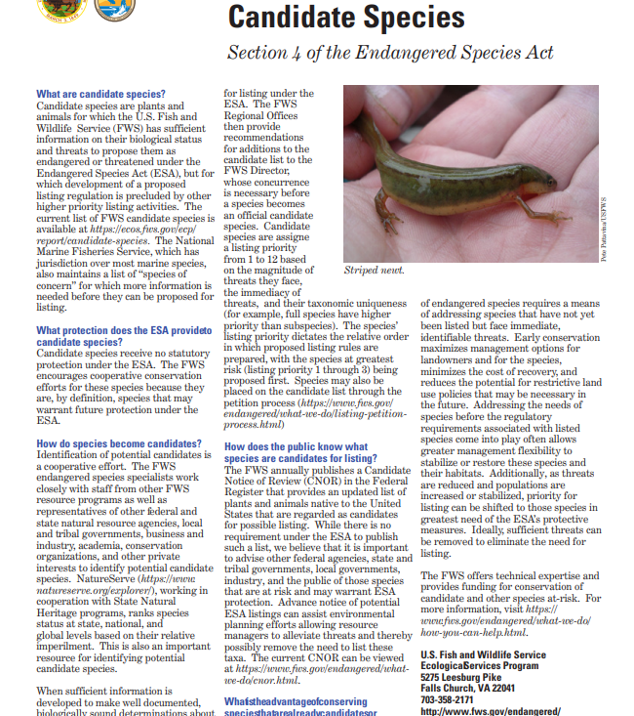
Candidate species
Plants and animals for which the U.S. Fish and Wildlife Service (USFWS) has enough information to propose them as threatened or endangered under the ESA, but listing is currently precluded.
Implementing conservation efforts before species are listed increases the likelihood that more cost-effective conservation options are available, and conservation efforts will succeed.
https://www.fws.gov/media/candidate-species-fact-sheet
Notes:
Candidate Species are plants and animals for which the U.S. Fish and Wildlife Service (USFWS) has enough information regarding their biological status and threats to propose them as threatened or endangered under the ESA, but listing is currently precluded by higher priority listing activities.
Implementing conservation efforts before species are listed and their habitats become highly imperiled increases the likelihood that simpler, more cost-effective conservation options are available, and that conservation efforts will succeed.

Slide 6
Candidate conservation agreement with assurances (CCAA)
Addresses property owners’ concerns about potential land use restrictions that could occur if a species becomes listed under the ESA .
Voluntary agreement that provides incentives for non-federal landowners to conserve candidate and other unlisted species.
For the length of the agreement, landowners agree to undertake specific activities that address the identified threats to the DSL.
https://www.ac-foundation.com/projects
Notes:
A CCAA addresses property owners’ concerns about potential land use restrictions that could occur if a species becomes listed under the ESA by providing incentives for nonfederal property owners to engage in voluntary conservation activities that provide a net conservation benefit to the species.
A CCAA is a voluntary agreement that provides incentives for non-federal landowners to conserve candidate and other unlisted species likely to become candidates in the future.
For the length of the agreement, landowners agree to undertake specific activities that address the identified threats to the DSL.
The Texas Conservation Plan (TCP) for the DSL is a CCAA.

Slide 7
DSL BACKGROUND
Occurs in the sand dune complexes associated with shinnery oak in the Permian Basin of West Texas and Eastern New Mexico.
A Candidate Species currently proposed for Federal listing under the ESA throughout its range in Texas and New Mexico.
In Texas, the species is known or believed to occur in Andrews, Crane, Ector, Gaines, Ward and Winkler counties.
https://ecos.fws.gov/ecp/species/6631
Notes:
The Dunes Sagebrush Lizard, or DSL, is a habitat specialist.
It is a small lizard (about 2.8 inches long) that occurs in the sand dune complexes associated with shinnery oak in the Permian Basin of West Texas and Eastern New Mexico.
The DSL is a Candidate Species and currently proposed for Federal listing under the ESA throughout its range in Texas and New Mexico. The USFWS’s Proposed Rule to list the DSL as an Endangered Species under the ESA was published in the Federal Register on July 3, 2023.
In Texas, the species is known or believed to occur in the counties of Andrews, Crane, Ector, Gaines, Ward and Winkler.

Slide 8
Proposed rule to list the DSL
USFWS found that listing the species as an Endangered Species was warranted.
USFWS determined that the designation of critical habitat was prudent but not determinable at the time of the proposed rule to list the species.
Critical habitat can be designated outside the geographical area occupied by the DSL at the time it is listed.
https://www.federalregister.gov/documents/2023/07/03/2023-13859/endangered-and-threatened-wildlife-and-plants-endangered-species-status-for-the-dunes-sagebrush
Notes:
In the USFWS Proposed Rule for the DSL, USFWS found that listing the species was warranted, and if the proposed rule is finalized, USFWS will add the DSL to the List of Endangered and Threatened Wildlife and extend the ESA’s protections to the species.
USFWS determined that the designation of critical habitat was prudent but not determinable at the time of the proposed rule to list the species. The ESA allows USFWS an additional year to publish critical habitat designation.
Critical habitat can be designated OUTSIDE the geographical area occupied by the DSL at the time it is listed, upon a determination that such areas are essential for the conservation of the species.

Slide 9
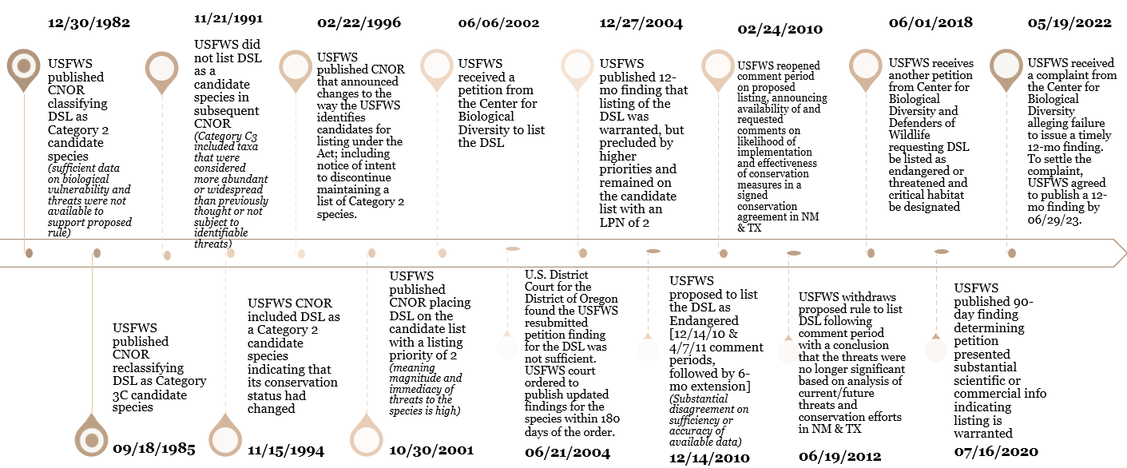
DSL Previous federal actions
Notes:
Deliberations over the DSL’s status date all the way back to 1982.
The most recent federal actions that shaped where we are today include the:
January 6, 2018, Center for Biological Diversity and Defenders of Wildlife petition to the USFWS requesting the DSL be listed as endangered or threatened and critical habitat be designated;
In response to this petition, the USFWS published a 90-day finding determining the petition presented substantial scientific or commercial information indicating listing is warranted
On May 19, 2022, USFWS received a complaint from the Center for Biological Diversity alleging failure of the USFWS to issue a timely 12-month finding. To settle this complaint, USFWS agreed to publish a 12-month finding by 06/29/2023.

Slide 10
2023 DSL Proposal to list timeline
https://www.regulations.gov/document/FWS-R2-ES-2022-0162-0005
07/03/2023 – USFWS published Proposed Rule to list the DSL in the Federal Register and USFWS Species Status Assessment (SSA) for the DSL. This document served as a 12-month finding for the 2018 petition and opened a 60-day comment period, which seeks input on the proposal to list the DSL.
07/31/2023 – USFWS held a virtual public informational session and public hearing.
08/30/2023 – USFWS published a 30-day extension on the public comment period in the Federal Register.
10/02/2023 – USFWS extended public comment period closed
Notes:
On July 3, 2023, USFWS published the Proposed Rule to list the DSL in the Federal Register along with the USFWS Species Status Assessment (SSA) for the DSL. This document serves as a 12-month finding for the 2018 petition and opened a 60-day comment period in which the USFWS was seeking input on the proposal to list the DSL. This comment period was extended and closed on October 2, 2023. Shortly after the proposed rule was published, on July 31, 2023, USFWS also held a virtual public informational session and public hearing.

Slide 11
- upcoming – 2024 deadlines DSL Proposal to list
06/03/2024 – ACF deadline for accepting enrollment in the TCP
07/03/2024 – USFWS deadline for final listing determination on the proposal to list the DSL as Endangered.
07/03/2025 – USFWS deadline of additional year to publish critical habitat designation.
Notes:
We currently have three timeclocks ticking:
The first one is for June 3, 2024. ACF will be accepting enrollment in the TCP through June 3, 2024. Those interested in enrolling in the TCP will need to contact ACF by this date with their interest in enrolling.
The second one is for July 3, 2024. This is the USFWS deadline for the final listing determination on the proposal to list the DSL as Endangered. (The USFWS could publish a 6-month extension to push the final listing to 01/03/2025.)
The final one is for July 3, 2025. This is the USFWS deadline of up to an additional year to publish critical habitat designation.

Slide 12
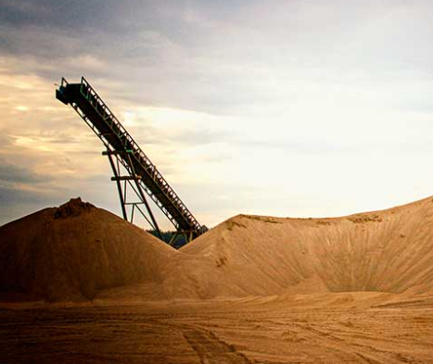
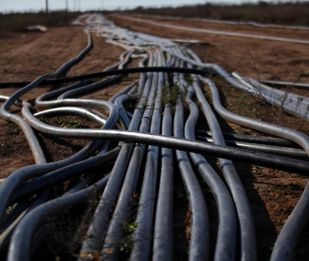
Texas conservation plan background
Finalized and approved by USFWS February 2012
A CCAA with a goal to provide a conservation benefit to the DSL.
USFWS transferred the Section 10 Permit for the DSL to ACF on September 20, 2020, and ACF accepted the transferred TCP Permit via signature on October 19, 2020.
The term of the TCP Permit is 30 years and set to expire or be renewed on February 17, 2042.
Notes:
The Texas Conservation Plan (TCP) was finalized and approved by USFWS in February of 2012. A permit was then issued to the Texas Comptroller of Public Accounts (CPA) as the original TCP Permit Holder. The TCP is a CCAA with a goal to provide a conservation benefit to the DSL.
After six years of implementation, the CPA notified USFWS that it had discontinued activities under the TCP and therefore surrendered the TCP and associated Section 10 Permit (TE55322A-0) for the DSL to the USFWS on November 8, 2018.
ACF then applied for the TCP Section 10 Permit for the DSL during this period in which the TCP Permit was surrendered to USFWS.
USFWS transferred the Section 10 Permit for the DSL to ACF on September 20, 2020, and ACF accepted the transferred TCP Permit (TE55322A-2) via signature on October 19, 2020.
As the previous administrator, the CPA contacted all enrolled TCP Participants via email to notify of the change in administration of the TCP on October 26, 2020. Those Participants interested in continuing enrollment in the TCP were directed to provide consent to release their CI to ACF. A group of the original Participants enrolled in the TCP on November 10, 2018, expressed interest in maintaining enrollment under the transferred Permit (Permit No. TE55322A-2). Those legacy TCP Participants released their CIs to ACF with the understanding their CIs would undergo a consistency review with FWS per the requirements of the transferred Permit. ACF did not receive any information from the CPA in regard to the identity of any Participants enrolled at the time the CPA held the TCP Permit.
The term of the TCP Permit is 30 years and set to expire or be renewed on February 17, 2042.

Slide 13
American conservation foundation, inc.
Established as a Texas based non-profit organization in August 2019.
Gene Richardson serves as President and Treasurer of ACF. A Board of Directors was established to include Shawn Wade, serving as Secretary, and Board Members Gary Austin and Richard Brantley.
Purpose of ACF: to contribute to the conservation of native ecosystems in a manner that incentivizes participation by private landowners and promotes economic development. ACF understands the importance of balancing these interests.
Mission of ACF: to investigate, implement, and promote conservation strategies that are science-based, responsible, grounded in common sense, and durable for the benefit of species and habitat.
https://www.ac-foundation.com/
Notes:
ACF was established as a Texas based non-profit organization in August 2019.
The purpose of ACF is to contribute to the conservation of native ecosystems in a manner that incentivizes participation by private landowners and promotes economic development. ACF understands the importance of balancing these interests.
Along side Gene as President and Treasurer of ACF, ACF established a Board of Directors which includes Shawn Wade, serving as Secretary, and Board Members Gary Austin and Richard Brantley.
The mission of ACF is to investigate, implement, and promote conservation strategies that are science-based, grounded in common sense, and durable for the benefit of the species and habitat.

Slide 14
Enrollment in the tcp
Private entities conducting activities in the Permit Area may voluntarily choose to participate in the TCP by signing a Certificate of Inclusion (CI) under the CCAA to avoid or minimize and mitigate impacts to Hibbitts DSL habitat that may occur as a result of their operation’s Covered Activities
Notes:
Private entities conducting otherwise lawful activities in the TCP Permit Area that may cause incidental take of the DSL may voluntarily choose to participate in the TCP by signing a Certificate of Inclusion (CI) under the CCAA to avoid or minimize and mitigate impacts to Hibbitts DSL habitat and 200 m buffer that may occur as a result of their operation’s Covered Activities.
As you can see from this map, the TCP Permit Area includes the Texas counties of Gaines, Andrews, Winkler, Ector, Ward and Crane.

Slide 15
TCP Enrollment process
Enrollment in the TCP is currently OPEN through June 3, 2024
Those interested in enrolling should contact ACF via our website or email with their desire to obtain additional information and/or enroll.
If interested in enrolling, you will complete and return the CI and Management Plan and provide ACF with a shapefile of the acreage you wish to enroll.
https://www.ac-foundation.com/contact
Notes:
Enrollment in the TCP is currently OPEN, however, enrollment is currently only open through June 3, 2024, to allow ACF enough time to fully enroll Participants before the potential final listing date for the DSL.
If you’re interested in enrolling, you can reach out to us either via the ACF website at www.ac-foundation.com or by sending an email to ACF’s Administrative Assistant at admin@ac-foundation.com. You will just need to reach out with your desire to obtain additional information and/or to enroll. Potential participants will be provided program requirements, to include a copy of the TCP, CI and Management Plan, and other materials as requested to review.
If you’re interested in enrolling, you will complete and return the CI and Management Plan to ACF and provide ACF with a shapefile of the acreage you wish to enroll. You will then be provided your Enrollment Fee invoice and Assessment Fee invoice, if applicable, based on your requested enrollment.
You can also visit the ACF website for helpful information, such as the TCP and the USFWS Proposed Rule to list the DSL documents.

Slide 16
DSL Maps/models
The TCP is based on the DSL Likelihood of Occurrence Map created by Toby Hibbitts of Texas A&M
DSL Habitat is classified into four approximated gradients of likelihood of DSL occupancy.
USFWS expressed interest in discussing mapping DSL habitat to ensure take coverage is based on the best available data.
ACF contracted with Texas A&M AgriLife Research of the Texas A&M University System (TAMU) for the development of a spatially explicit habitat model for the DSL. This model was developed for ACF to be scientifically rigorous and defensible, representing the best available methodology to determine DSL habitat suitability and has been peer reviewed and published.
Notes:
Now let’s talk about the hot topic – DSL Maps and Models.
The TCP is based on the DSL Likelihood of Occurrence Map created by Toby Hibbitts of Texas A&M in May of 2011.
The Hibbitts map was created using aerial photography to identify shinnery dunes habitat with all historical museum records, survey records from Laurencio et al. (2007) and recent survey information by Texas A&M overlaid onto the map.
DSL Habitat is classified into four approximate gradients of likelihood of DSL occupancy. These four categories are:
Very High (Dark Green)
High (Light Green)
Low (Orange)
Very Low (Red)
In the September 30, 2020, USFWS transmittal letter to ACF when ACF was transferred the TCP Permit, USFWS expressed interest in discussing mapping DSL habitat to ensure take coverage is based on the best available data. USFWS stated the TCP’s Hibbitts map no longer represented the best available science on DSL habitat locations and that the DSL habitat suitability model/map Hardy et al. (2018) delineated areas where take coverage would be necessary.
ACF then contracted with Texas A&M AgriLife Research of the Texas A&M University System (TAMU) on January 17, 2021, for the development of a spatially explicit habitat model for the DSL. This model was developed for ACF to be scientifically rigorous and defensible, representing the best available methodology to determine DSL habitat suitability and has been peer reviewed and published.

Slide 17
DSL Maps/models cont.
USFWS posted the Species Status Assessment (SSA) for the DSL to be used to inform the listing determination for the DSL.
The USFWS DSL SSA included a map of Texas DSL habitat of both current conditions; and under future projections with outlines for the 4 Analysis Units used to describe the condition of the DSL in the Monahans Representation Units.
Notes:
On July 3, 2023, USFWS published the Species Status Assessment (SSA) for the DSL to be used to inform the listing determination for the DSL. This report was prepared by biologists from USFWS.
This SSA included a map of Texas DSL habitat of both current and future projections in 2050 under Low, Medium, and High Scenarios with outlines for the 4 Analysis Units used to describe the condition of the DSL in the Monahans Representation Units.
It’s important to note that ACF continues to implement the TCP, which is based on the Hibbitts DSL map.
However, those interested in enrolling in the TCP are encouraged to assess their risk through the lens of the USFWS SSA map for assurances when considering whether to enroll.

Slide 18
Certificate of inclusion (ci)
Outlines the requirements of Participants in the TCP, including:
COVERED ACTIVITIES
CONSERVATION MEASURES
RESPONSIBILTIES
ASSURANCES
FEES AND ASSESSMENTS
TRANSFERS AND ADDITIONS
Notes:
The Certificate of Inclusion (CI) outlines the requirements of Participants in the TCP, including:
COVERED ACTIVITIES which are based on the type of operator you are.(i.e., Oil and Gas, Midstream, Surface Mining, etc.)
CONSERVATION MEASURES which limit development to areas outside of Hibbitts DSL Habitat and 200 m buffer. If avoidance of Hibbitts DSL habitat and 200 m buffer is not feasible, the Participant must implement Conservation Measures that minimize habitat impacts and, as a last resort, mitigate for the loss of DSL habitat, following the procedures in the TCP and Permit.
RESPONSIBILITIES. Participants are only responsible for implementing and maintaining the Conservation Measures and/or land management actions that he or she agreed to in the CI and complying with the terms and conditions of the TCP, Permit and CI. The Permit Holder, Gene, is responsible for overseeing and monitoring Participant’s compliance with the Conservation Measures, the TCP, and the Permit; and monitoring and documenting that the Participant’s Conservation Measures implemented on enrolled properties will provide a net conservation benefit to the DSL. Gene will conduct initial Habitat Impact Assessments for anticipated surface disturbances and work with the Participant to develop a Management Plan. Participants will update and submit the Management Plan annually to ACF to be attached to their CI.
ASSURANCES. In exchange for your commitment to undertake the Conservation Measures in your CI, and for full and complete compliance with, and implementation of the TCP and Permit, USFWS provides the Permit Holder and Participant with the regulatory assurances found at 50 CFR 17.22(d)(5) and 17.32(d)(5). Assurances means that, should the DSL become listed as threatened or endangered under the ESA in the near future, additional conservation measures and land, water, or resource use restrictions beyond those described in your CI will NOT be imposed with respect to Covered Activities by Participants. These assurances are authorized by the “enhancement of survival” permit issued under Section 10(a)(1)(A) of the ESA if the DSL is listed. Once issued, if necessary, the permit will authorize the incidental take of DSLs by Participants under the permit issued to Gene as Permit Holder as long as such incidental take is consistent with their CI. Further, in the event of any unforeseen circumstances, USFWS will NOT require the commitment of additional land, water, or other natural resources beyond the level otherwise agreed to for the species in their CI.
FEES AND ASSESSMENTS. The Annual Enrollment Fee is a set fee of $4.00/acre and due upon initial enrollment, and then on/by December 15th thereafter annually. The TCP also authorizes a periodical Assessment Fee as necessary to fund program administration. Participants shall pay an Assessment Fee, if applicable, within 90 days of receipt of written invoice. All fees and contributions made in support of the TCP may only be used to support the development, administration, and implementation of the TCP.
TRANSFERS AND ADDITIONS. TCP Participants may transfer their CI to another TCP Participant or successor in interest. TCP Participants may also transfer enrolled acreage to another TCP Participant. Notification of any transfers will be submitted to ACF within 30 days of closing of the transfer and must be acknowledged by ACF. TCP Participants may also enroll additional acreage or remove enrolled acreage through notification to ACF. These changes do not constitute an amendment to the CI or require signature of the Parties. (ACF shall assess an additional Enrollment Fee and Assessment Fee, if applicable, as necessary.) Keep in mind this is a PRE-LISTING Permit. Once the DSL is listed, NO additional acreage can be enrolled.

Slide 19
- upcoming – 2024 deadlines DSL Proposal to list
REMINDER
06/03/2024 – ACF deadline for accepting enrollment in the TCP
07/03/2024 – USFWS deadline for final listing determination on the proposal to list the DSL as Endangered.
07/03/2025 – USFWS deadline of additional year to publish critical habitat designation.
Notes:
As a reminder, we currently have three important timeclocks ticking right now:
The first one is for June 3, 2024. ACF will be accepting enrollment in the TCP through June 3, 2024. Those interested in enrolling in the TCP will need to contact ACF by this date with their interest in enrolling.
The second one is for July 3, 2024. This is the USFWS deadline for the final listing determination on the proposal to list the DSL as Endangered. (The USFWS could publish a 6-month extension to push the final listing to 01/03/2025.)
The final one is for July 3, 2025. This is the USFWS deadline of up to an additional year to publish critical habitat designation.

Slide 20
Questions?
SUBMIT QUESTIONS VIA THE ZOOM CHAT.
Questions will be answered in the order received.
CONFIDENTIALITY – ONLY ACF AS THE MEETING ADMINISTRATOR WILL SEE YOUR QUESTION.
ACF will read your question aloud while maintaining your confidentiality.
Notes:
Q&A session via Zoom chat

Slide 21
THANK YOU!
Notes:
Gene – close the presentation/thank the audience for attending

